Slide 1
Social Network Metrics

Slide 2
Types of network metrics
Group level
Density
Components
Isolates
Cliques
Centralization
Degree
Closeness
Betweenness
Factions
Core-periphery
Node level
Centrality
Degree
Indegree
Outdegree
Closeness
Betweenness
Visualization
Netdraw
Mage
QAP
Statistical metrics
MDS
Cluster analysis

Slide 3
Preparing the data
Most graph-based metrics require symmetric, dichotomous (binary) data
Symmetrization
Minimum (captures reciprocal ties)
Maximum (most inclusive)
Dichotomize
Valued data are typically ordinal
Mean, median or modal values

Slide 4
Network Density
The proportion of ties that exist out of all possible ties
For valued data the sum of all tie strengths divided by all possible ties

Slide 5
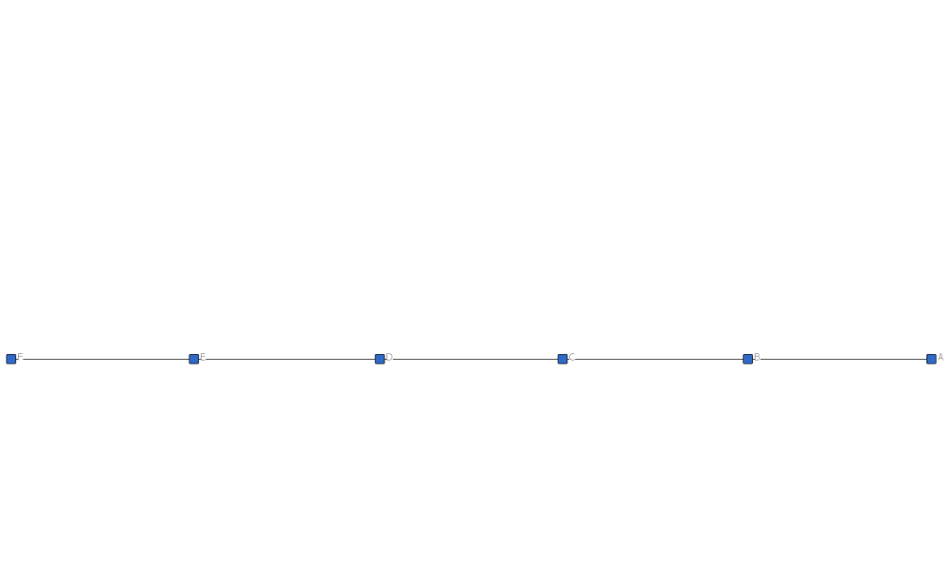
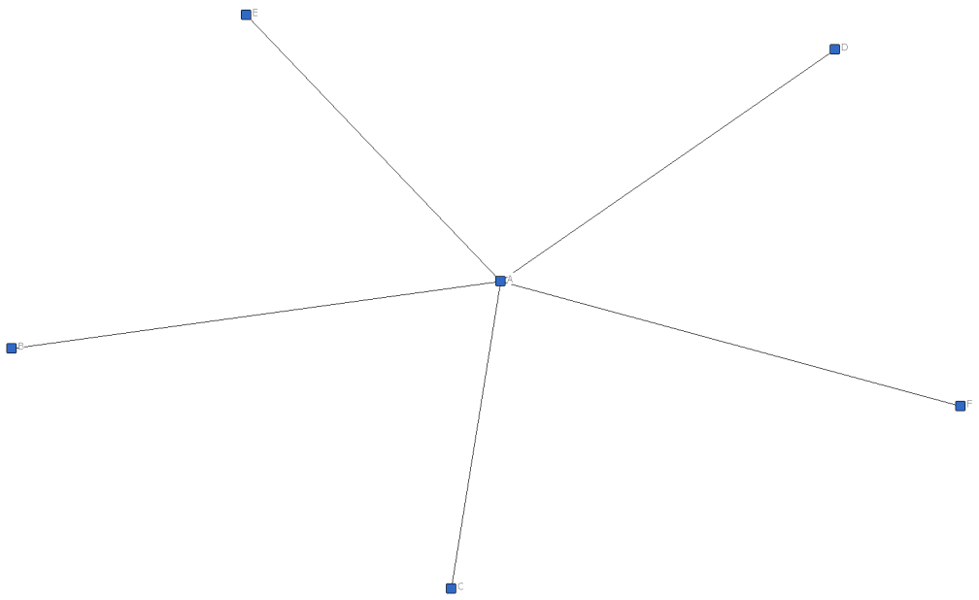
Density is a course measure
Density = .33
Degree centralization = 10%
Density = .33
Degree centralization = 60%

Slide 6
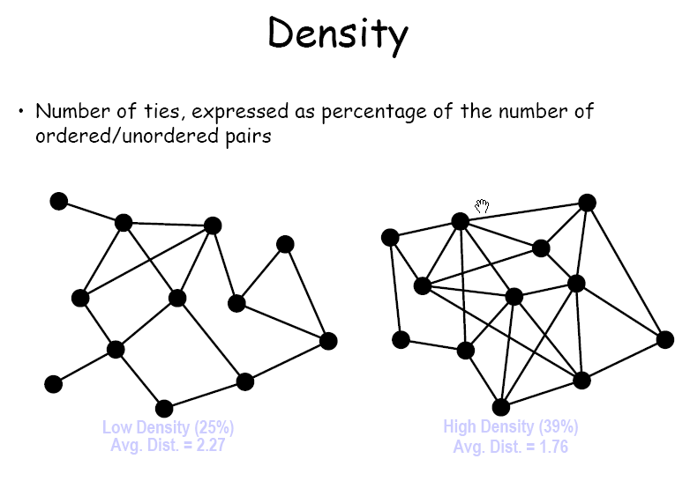

Slide 7
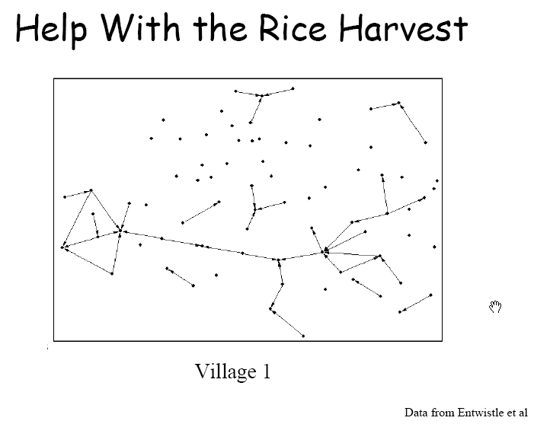
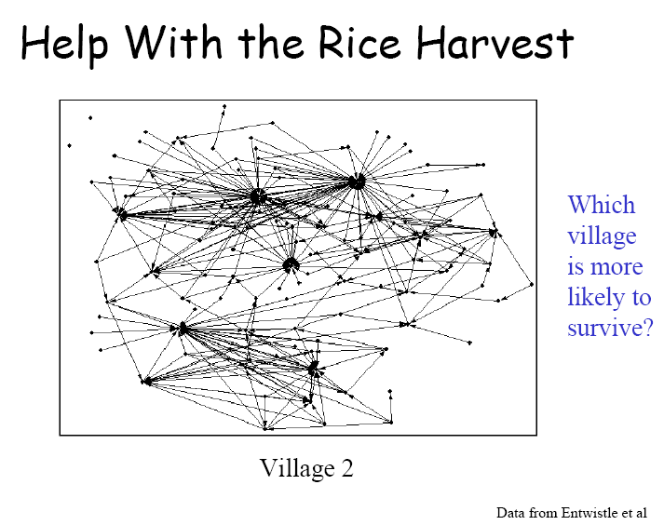

Slide 8
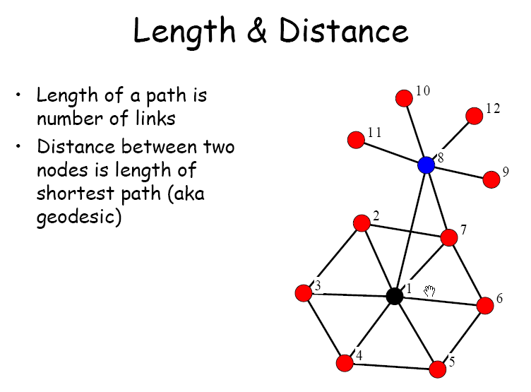

Slide 9
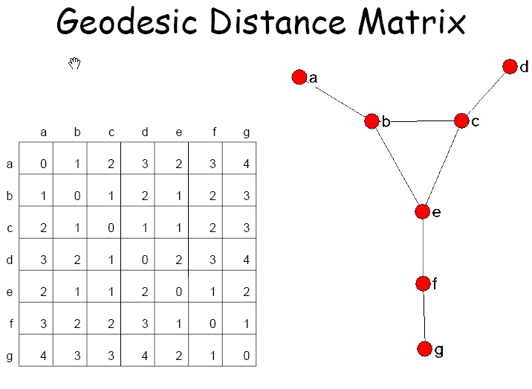

Slide 10
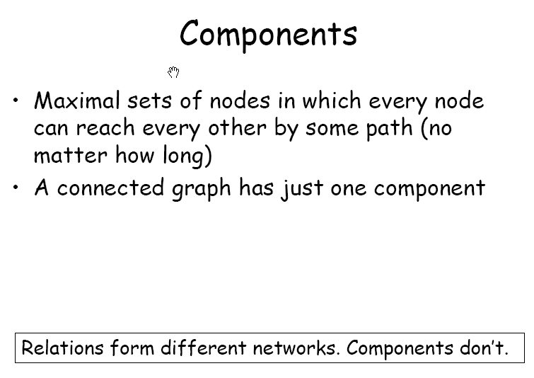

Slide 11
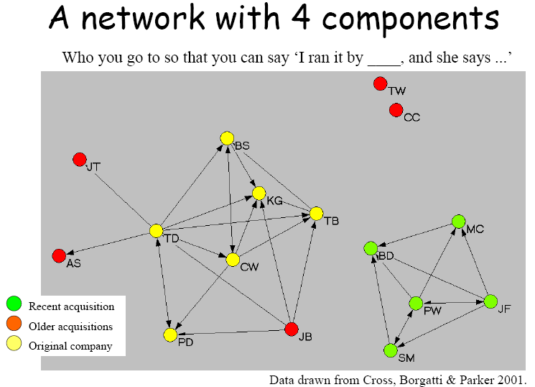

Slide 12
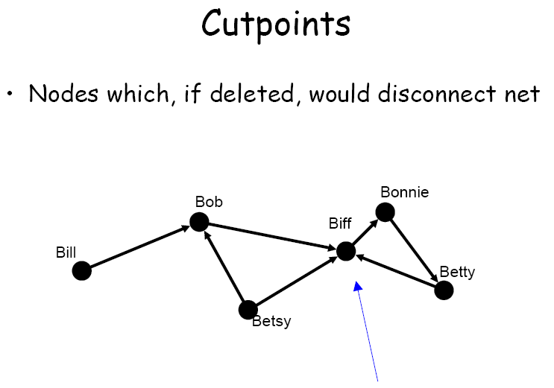

Slide 13
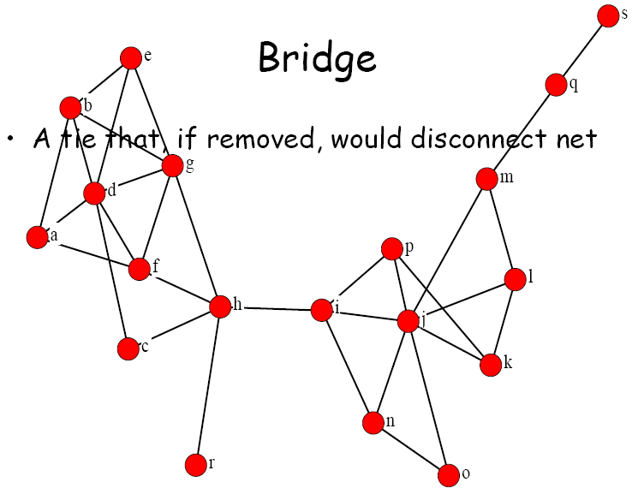

Slide 14
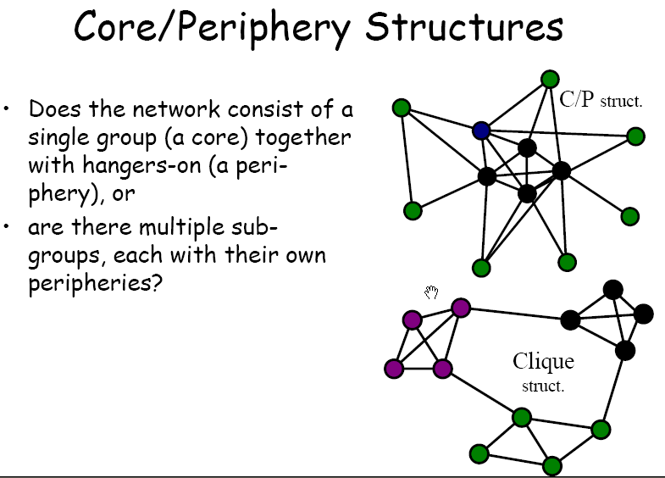

Slide 15
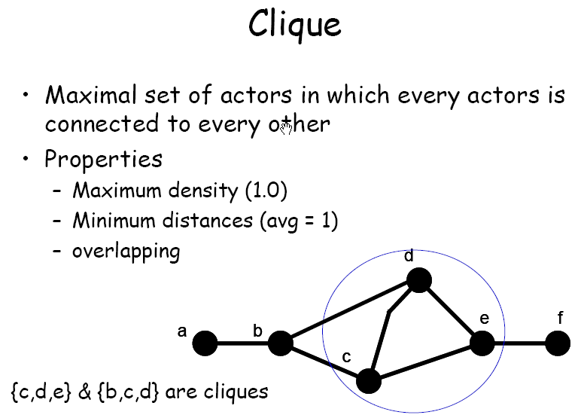

Slide 16
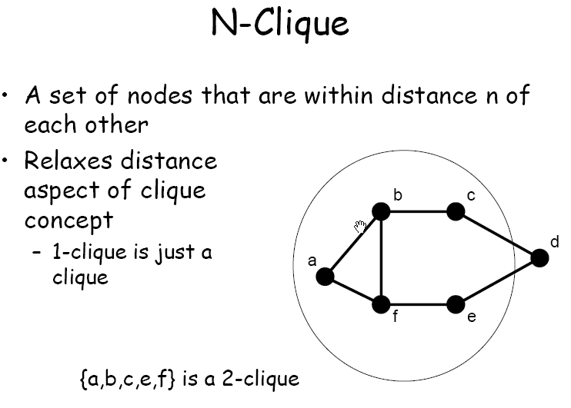

Slide 17
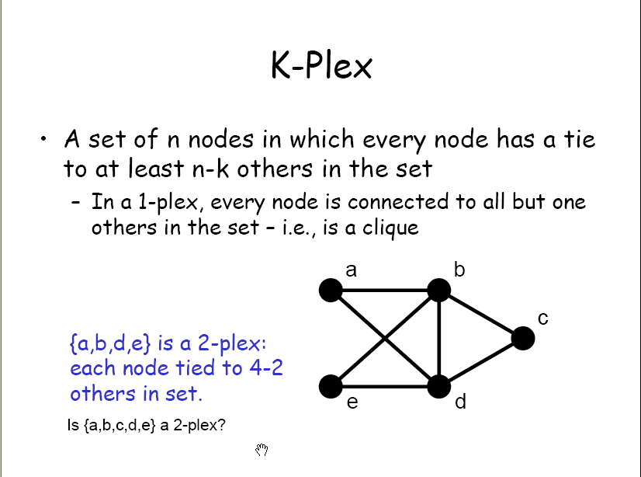

Slide 18
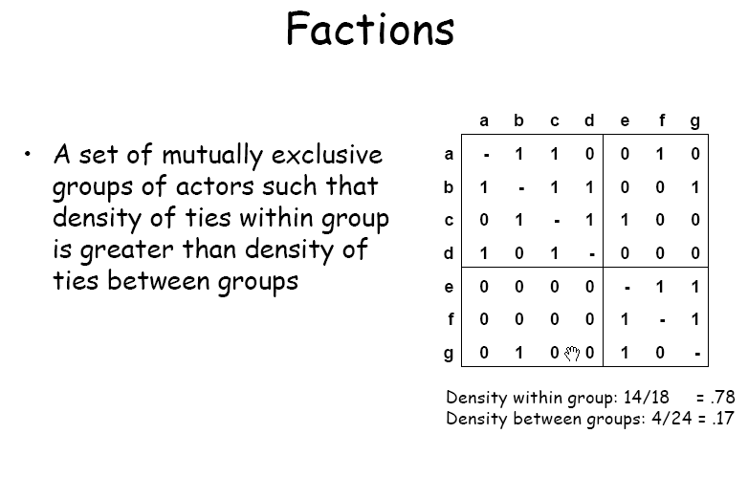

Slide 19
Centrality versus centralization
Centrality is a node level metric; each node has a centrality score representing it’s position within the network
Centralization is a group level metric indicating the extent to which the network is dominated by one or a few nodes

Slide 20
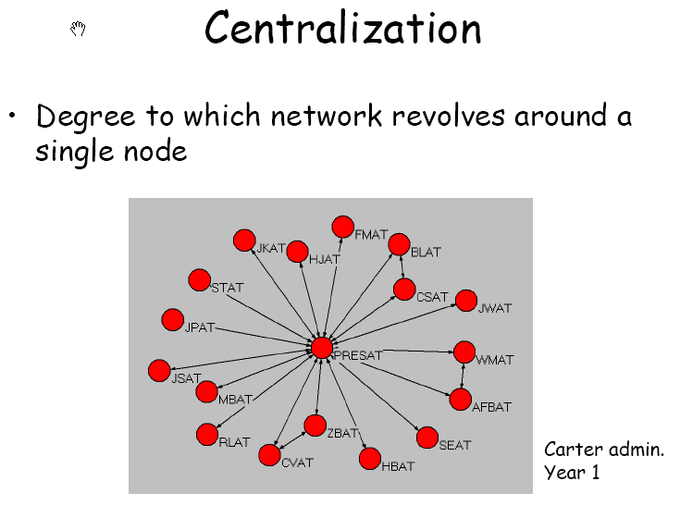

Slide 21
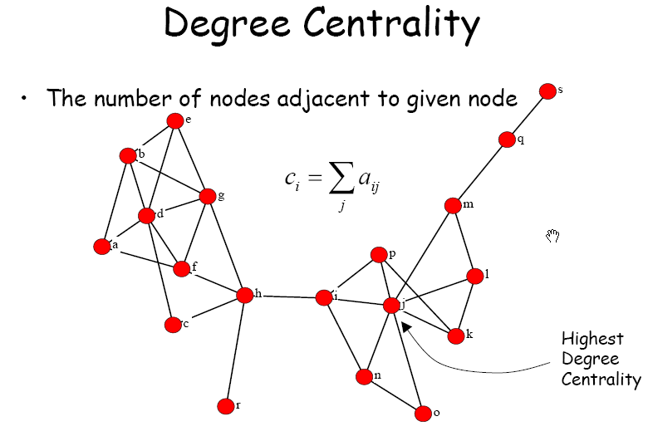

Slide 22
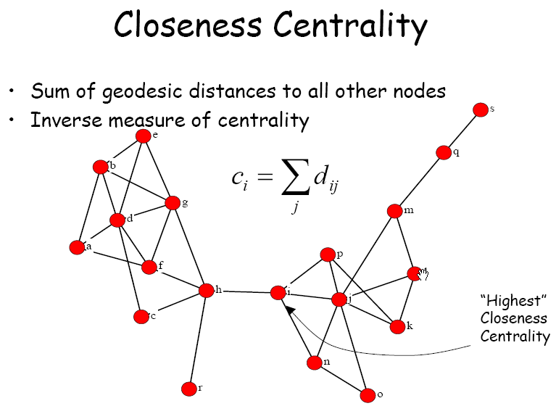

Slide 23
